Slide 1
Azure Function App Health
Abusing the Azure Functions Runtime for fun and profit

Slide 2

About Me
Architecture & Engineering Leader | Technical Speaker | Passionate about Engineering Excellence
Over 25 years of development experience
Speaker for 10 years
Coder for life!

Slide 3
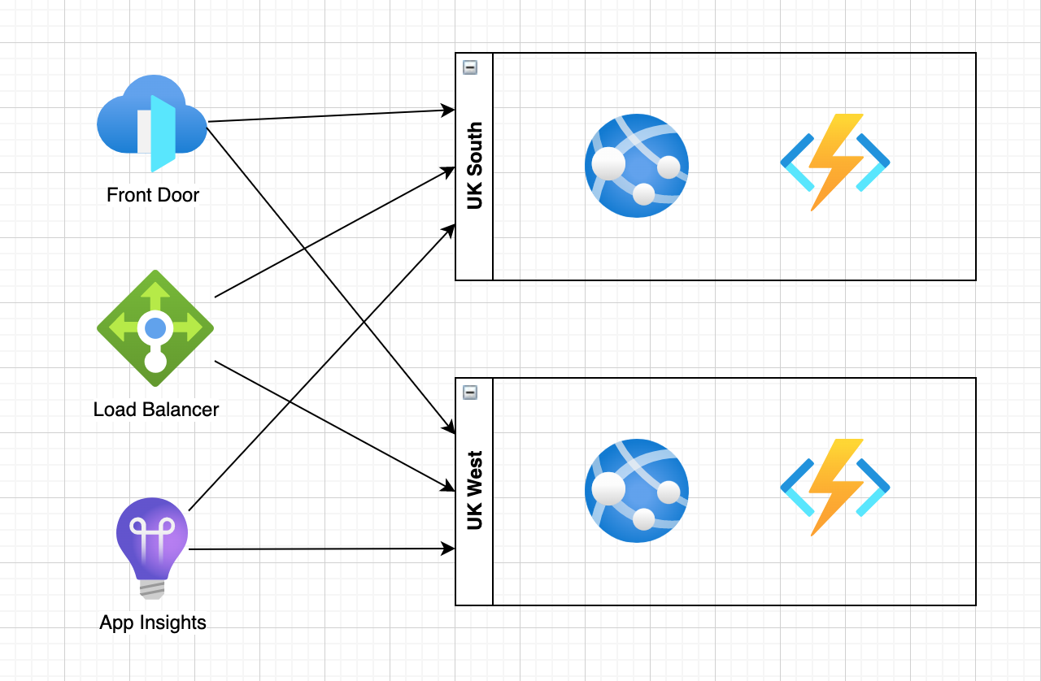
Health Check Endpoint Pattern
Instances expose health endpoint
👍 Healthy
🤢 Degraded
☠️ ☠️ ☠️
Monitoring systems poll health endpoints of all instances
Traffic routed accordingly
https://microservices.io/patterns/observability/health-check-api.html

Slide 4
Demo
Zero to ASP.Net Core Web API Health

Slide 5
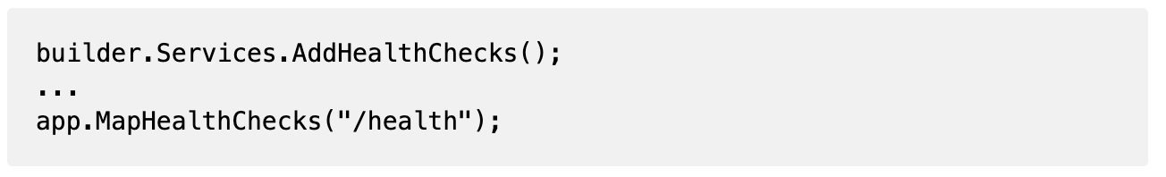
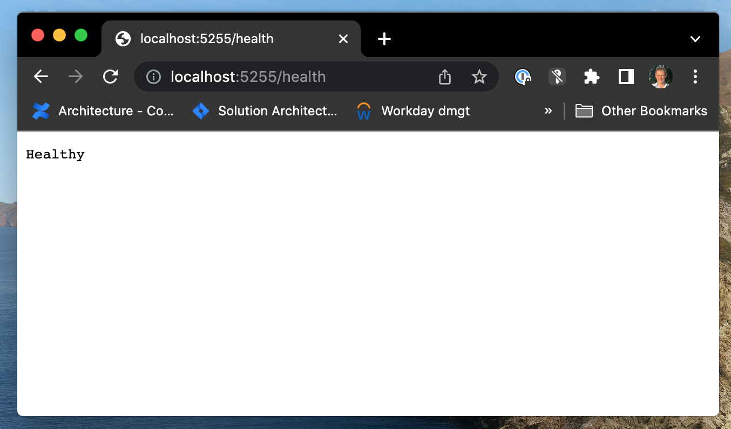
ASP.Net Web API
To add the standard health endpoint
Then add health checks

Slide 6
Azure Function Apps (In Proc)
Azure Functions Runtime
Doesn’t support WebApplicationBuilder 😢
Doesn’t support programmatic routing 😞
Doesn’t support functions in separate assemblies 😫
Does support ‘Extensions’ 😎
https://github.com/Azure/azure-functions-openapi-extension

Slide 7
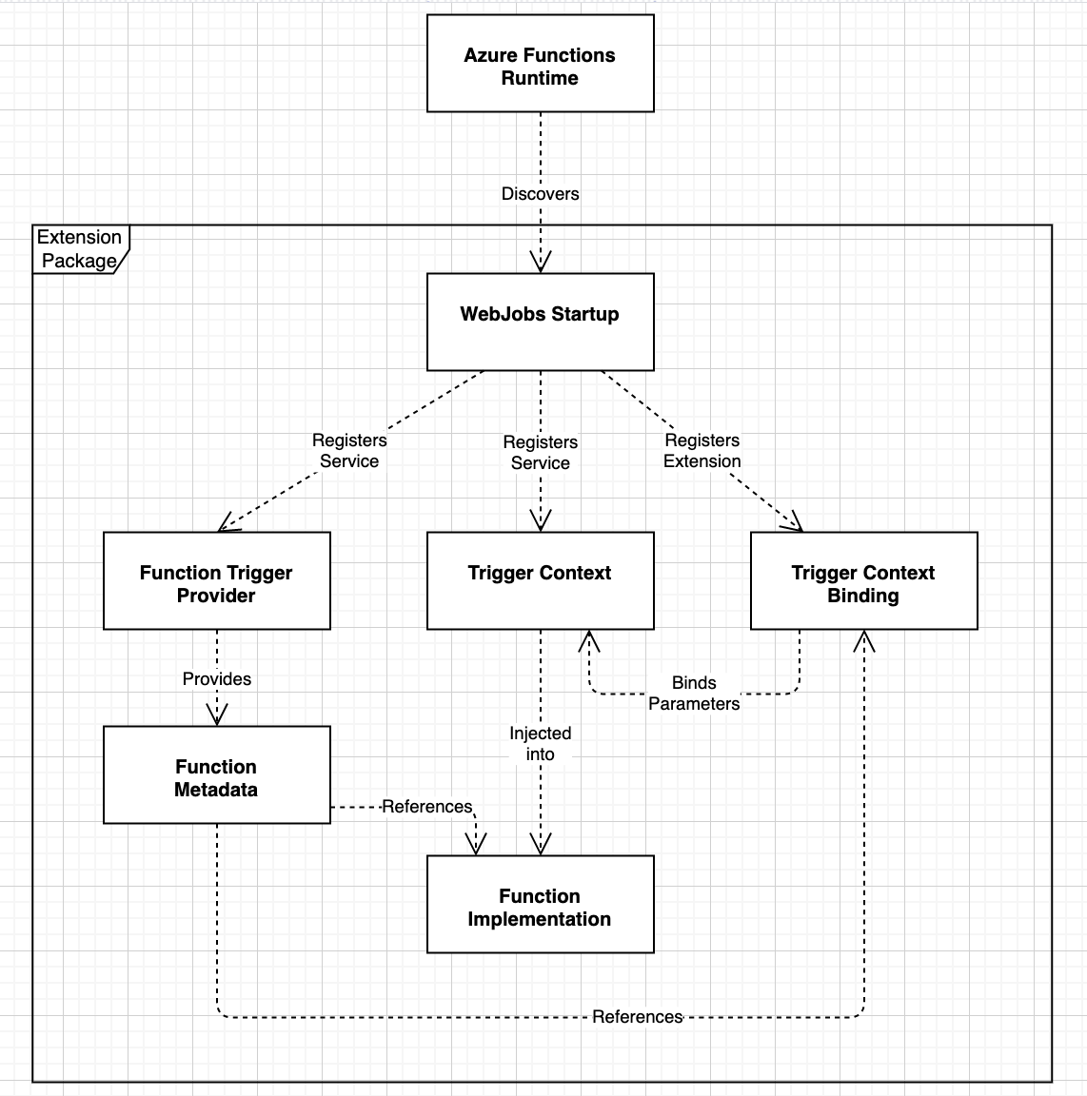
Anatomy of an Extension
WebJobs Startup
Registers Services & Extension
Trigger Provider
Registers function metadata
Trigger Context Binding
Allows config / service injection
Via Tigger Context class
Function Implementation
Does the work!

Slide 8
Demo
Azure Function App (In Proc) Health

Slide 9
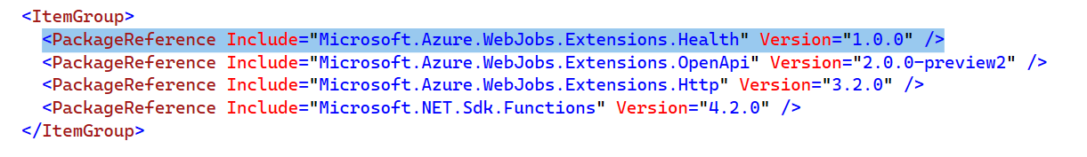
Azure Function App (In-Process)
To add the standard health endpoint
Then add health checks

Slide 10
Other Uses
Cache Pre-loading / Refresh
No timer-function delay
Dependencies with slow-start
LaunchDarkly Client

Slide 11
Azure Function Apps (Out Of Proc)
Azure Functions Runtime is “different” again
Doesn’t support WebApplicationBuilder 😢
Doesn’t support programmatic routing 😞
Does support functions in separate assemblies 😎
No need for xxxFunctionProvider abuse 😎
https://github.com/Azure/azure-functions-openapi-extension

Slide 12
Summary / Resources
You can add dynamic functions to Azure Function Apps
WebJobsStartup / WorkerExtensionStartup classes
Host-level registrations
JSON Serialization ”abuse” is required because of internal metadata models 😡
Static function methods
Injection via xxxTriggerContext classes
Sample Repo
https://github.com/Rammesses/Azure.Functions.HealthEndpoints

Slide 13
Thanks / Contact
Em: joel@Hammond-turner.org.uk
Tw: twitter.com/Rammesses
Gh: github.com/Rammesses
Li: linkedin.com/in/joelht

